Slide 1



Planning Actions for Continuous Improvement
Summer 2020 Workshop: Content Series #7
presented by: Dr. Summer DeProw
July 27, 2020
AState.edu
/ArkansasState
@ArkansasState

Slide 2



Workshop Procedures
Welcome and thank you for participating in our Summer Workshop Series!
You will be muted upon entry to the workshop, so please introduce yourself via the Chat feature by clicking “Chat.”
The window to the right will appear where you can add your introduction:
If you have questions during the session, please add them to the Chat box and at the conclusion of our time we will include them in the Q and A.
AState.edu
/ArkansasState
@ArkansasState

Slide 3
Workshop Agenda
Attendees will be able to:
Action Planning for Continuous Improvement
Talking to your peers about the program
Identify the Action Plan per measure based on Assessment Findings:
Student Learning Data is acceptable and monitoring will continue
Student Learning Data is not-acceptable and action will need to be taken
Student Learning Data is unreliable or a process change is needed
AState.edu
/ArkansasState
@ArkansasState

Slide 4
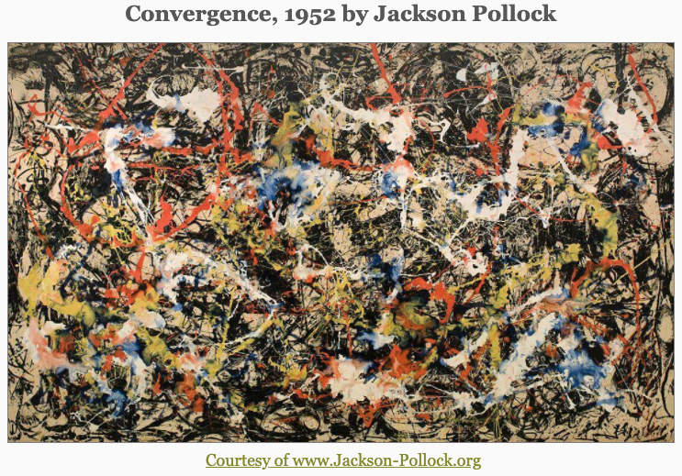
Organize the people and strategies for learning improvement……
AState.edu
/ArkansasState
@ArkansasState

Slide 5
Assessment Cycle without Action
Learning Outcomes
Curriculum Mapping
Direct and Indirect Measures
Data Collection
Analyze and Interpret Data
Write Annual Report to Document
AState.edu
/ArkansasState
@ArkansasState

Slide 6
Assessment Cycle WITH Action
“A pig never fattened up only because it was weighed. A racehorse never ran faster because a stopwatch was clicked. A fevered dog’s temperature never dropped as a result of reading a thermometer.” (Fulcher, et al, 2014).
What does this have to do with Student Learning Assessment?
Just because outcomes are written, mapping and alignments are constructed, planning is done, measures are crafted and implemented, and data is collected, student learning assessment is NOT complete without action.
AState.edu
/ArkansasState
@ArkansasState

Slide 7
Systemic Barriers
“Harvard President, Derek Bok (2013) roundly criticized graduate schools for this lack of teaching preparation. Indeed, relative to research, master’s, and doctoral students receive far less training in teaching during their graduate programs. In fact, it seems that conversation about teaching are taboo compared to frequent conversations about scholarship. Even if a faculty member adopts an evidence-based pedagogy, that lone faculty member will not bring about programmatic changes. Programs are made up of teams of faculty, and everyone must be on board (a challenge within itself) to general meaningful changes.” (Fulcher, et al, 2014, p. 8).
What do you think?
AState.edu
/ArkansasState
@ArkansasState

Slide 8
Action Plans for Continuous Improvement
The George Washington University describes continuous improvement through action planning as “…data collection is of little value unless the data are shared at the institutional and program levels and used to improve teaching and learning. The data needs to be used to reevaluate and/or revise the curriculum or individual courses to achieve program learning outcomes. The assessment process is complete only when the information has been used to improve student learning. (Some accrediting agencies refer to this as "closing the loop.")”
How do we “close the loop?!
AState.edu
/ArkansasState
@ArkansasState

Slide 9
Action Planning: Beginnings
Action Planning is not the beginning of Student Learning Assessment!
First, the course or program must:
Asses
Intervene
Reassess
Act?! Yes, then…
Faculty Involvement
AState.edu
/ArkansasState
@ArkansasState

Slide 10
Action Planning: Intervention
When ready for intervention, process lead by Assessment Leader and include key faculty who are experts in pedagogy, curriculum and content will include:
Identifying Targeted Data and Learning Outcome
Analyze Current Process and Efforts
Propose Modifications
Create Timetable and Steps
AState.edu
/ArkansasState
@ArkansasState

Slide 11
Identify Targeted Data
AState.edu
/ArkansasState
@ArkansasState

Slide 12
Identifying Targeted Data in Rubrics
AState.edu
/ArkansasState
@ArkansasState

Slide 13
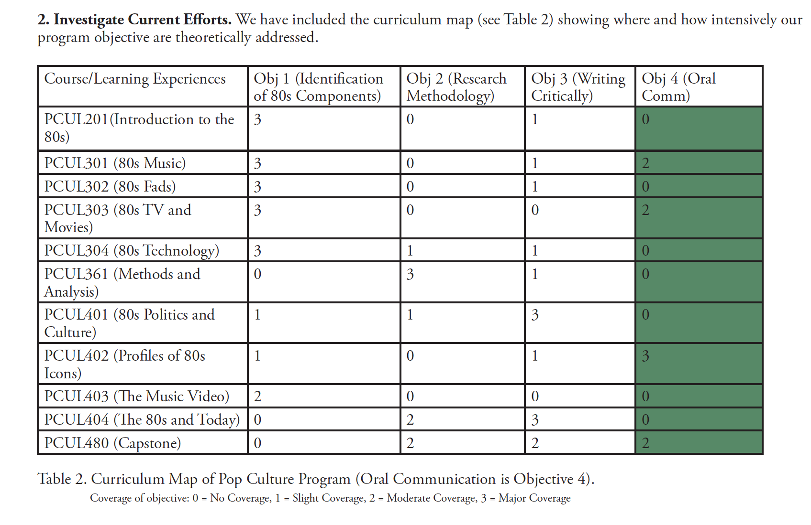
Curriculum Map + Assignments
AState.edu
/ArkansasState
@ArkansasState

Slide 14
Action Plans in Practice
A. Student Learning Met
B. Student Learning Not-Met
C. Process Invalid
Action Plan
AState.edu
/ArkansasState
@ArkansasState

Slide 15
Action Plan “Buckets”
There are 3 “buckets” or scenarios that Action Plans are created from:
A. Student learning is met:
A valid and reliable instrument is being used to assess student learning where alignment between learning outcome(s) and measure is clear and student learning meets the defined or prescribed benchmark.
B. Student learning is NOT met:
A valid and reliable instrument is being used to assess student learning where alignment between learning outcome(s) and measure is clear, but student learning is does NOT meet the defined or prescribed benchmark.
C. Process is invalid or flawed:
Assessment leader and program or course faculty do not trust the instrument, alignment of outcomes or process used to collect student learning assessment data and method must be changed to assure validity and reliability.
AState.edu
/ArkansasState
@ArkansasState

Slide 16
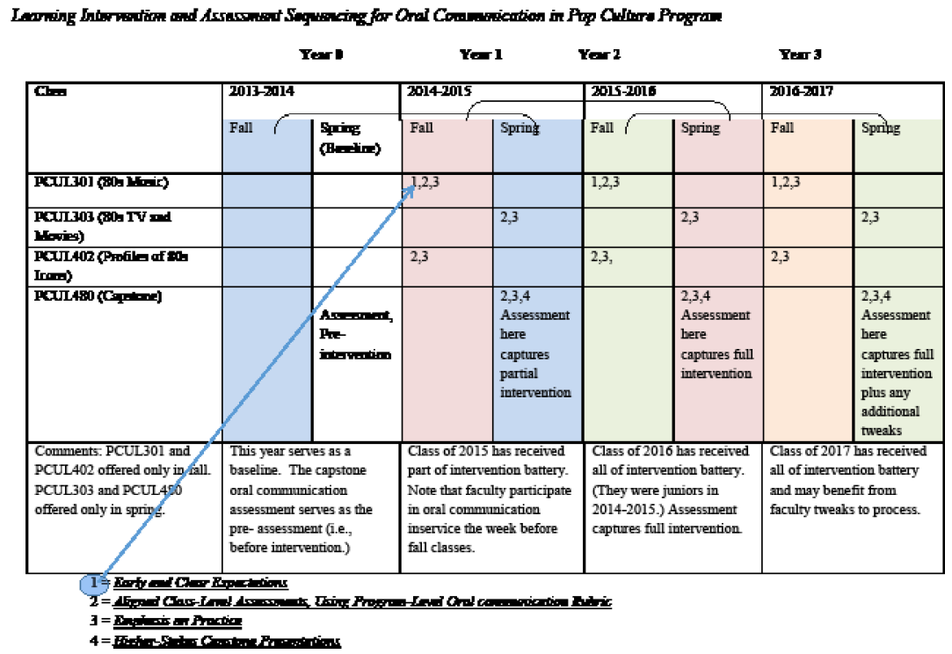
Interventions + Timeline + Who
AState.edu
/ArkansasState
@ArkansasState

Slide 17
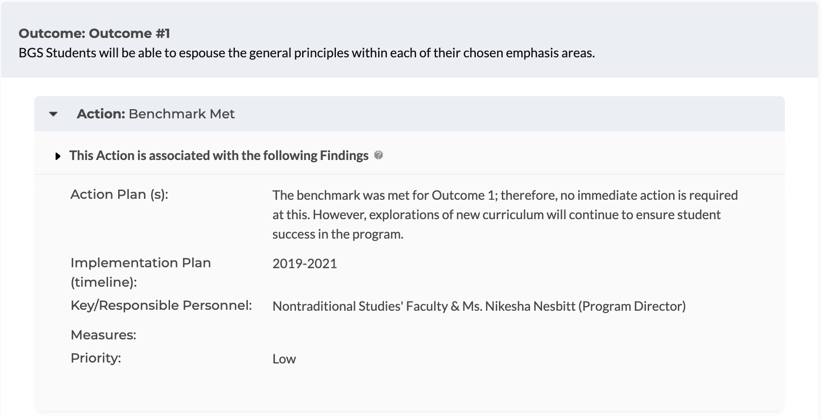
Action Plan
Examples:
AState.edu
/ArkansasState
@ArkansasState

Slide 18
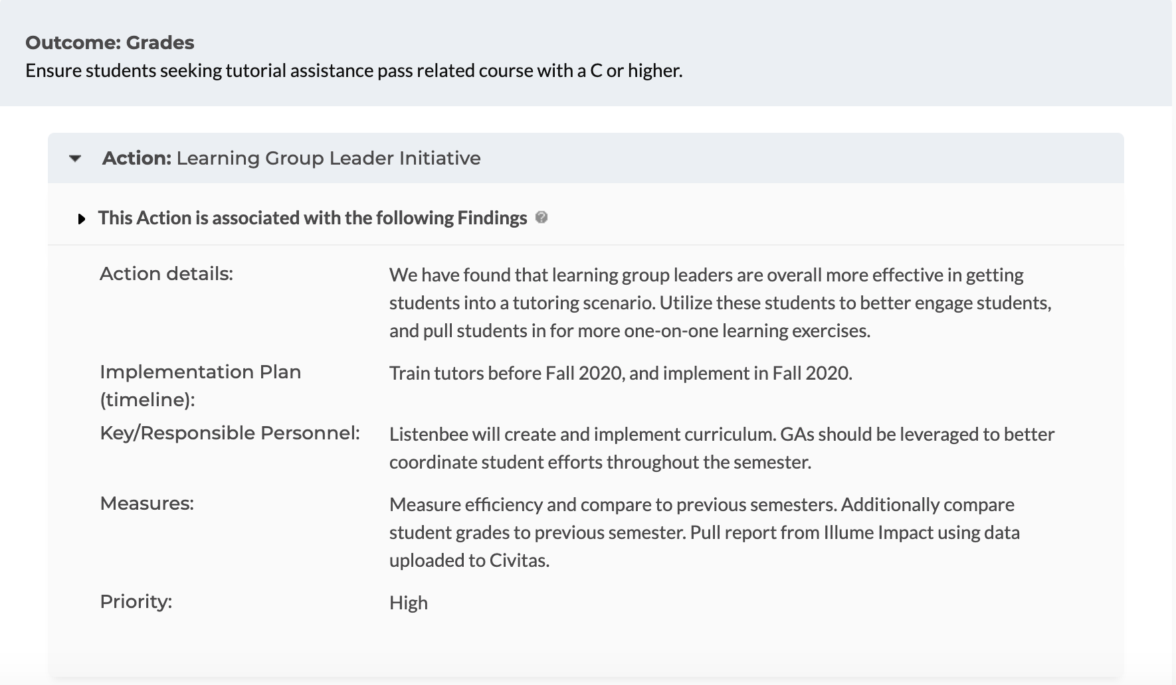
Action Plan
Examples:
AState.edu
/ArkansasState
@ArkansasState

Slide 19
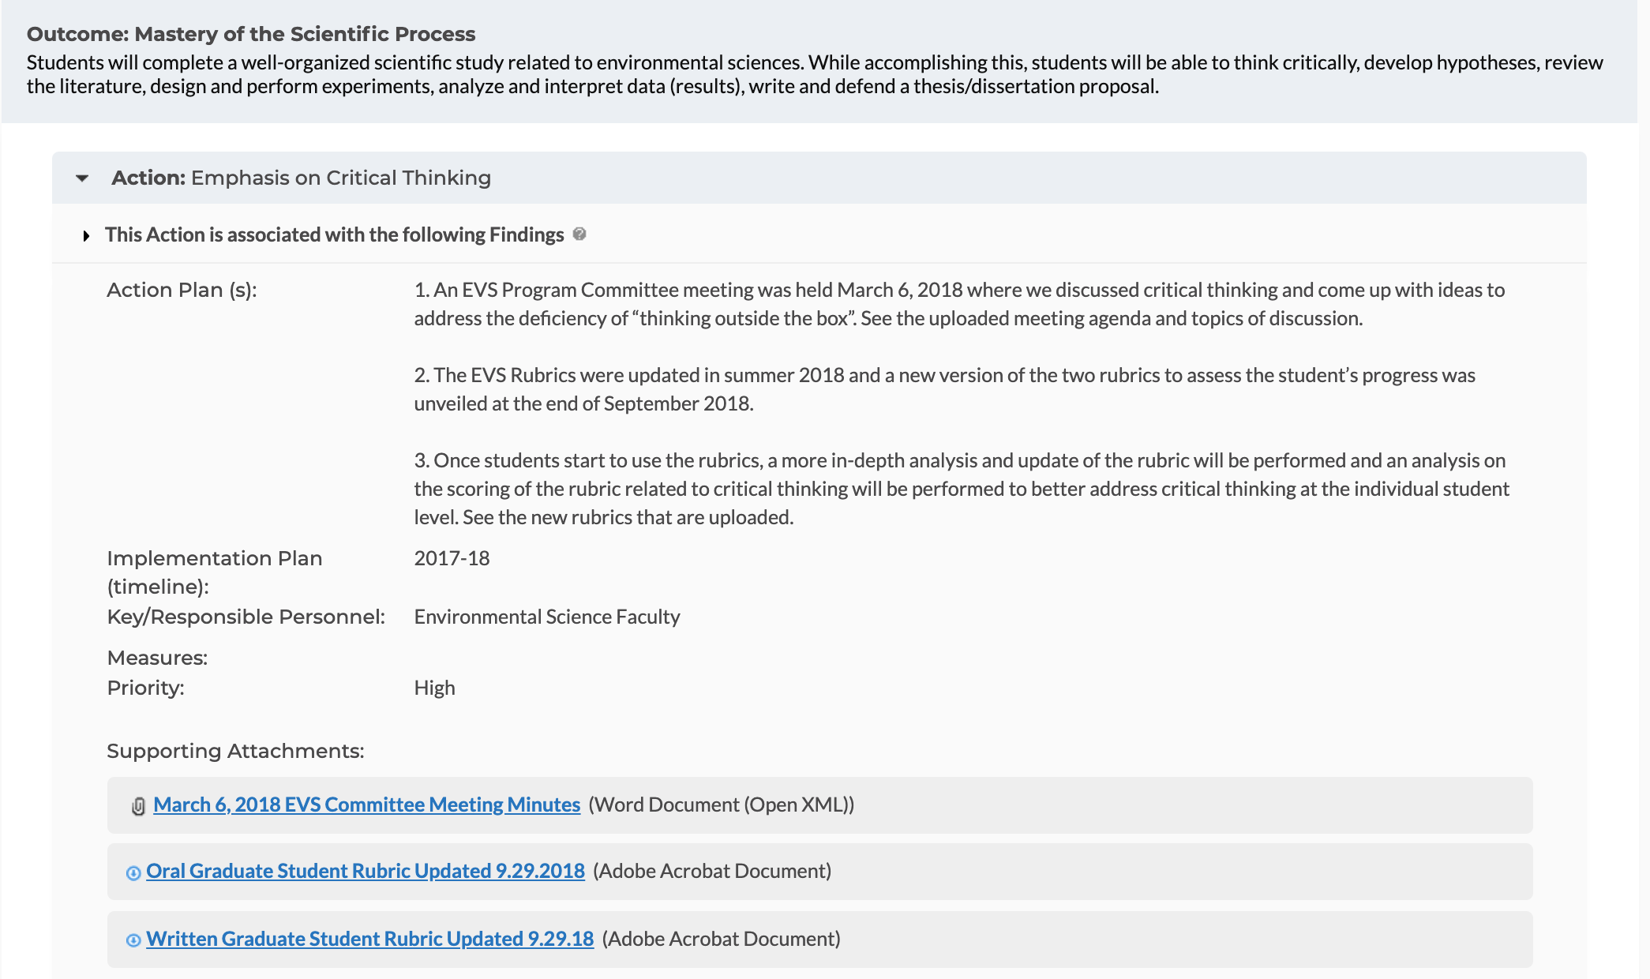
Action Plan
Examples:
AState.edu
/ArkansasState
@ArkansasState

Slide 20
Assessment Cycle with Action
Learning Outcomes
Curriculum Mapping
Direct and Indirect Measures
Data Collection and Analysis/Interpretation
Learning Interventions AKA Action Plans
Implement Learning Interventions
AState.edu
/ArkansasState
@ArkansasState

Slide 21
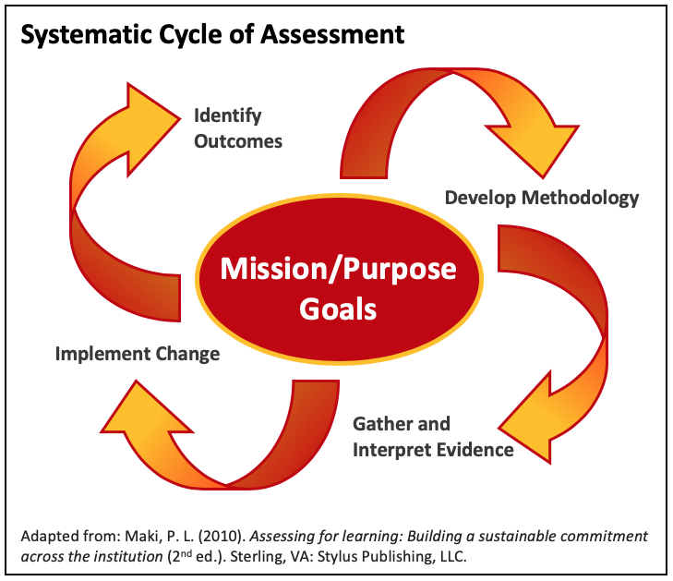
Assessment Cycle with Action
AState.edu
/ArkansasState
@ArkansasState

Slide 22

Session Q & A
AState.edu
/ArkansasState
@ArkansasState

Slide 23
References
Fulcher, K. H., Good, M. R., Coleman, C. M., & Smith, K. L. (2014, December). A simple model for learning improvement: Weigh pig, feed pig, weigh pig. (Occasional Paper No. 23). Urbana, Il: University of Illinois and Indiana University, National Institute for Learning Outcomes Assessment.*
*Many illustrations in this presentation (slide 12 and 15) are from Fulcher’s article.
AState.edu
/ArkansasState
@ArkansasState

